Slide 1
Network Performance Monitoring
Ege Bulut – D22124401

Slide 2
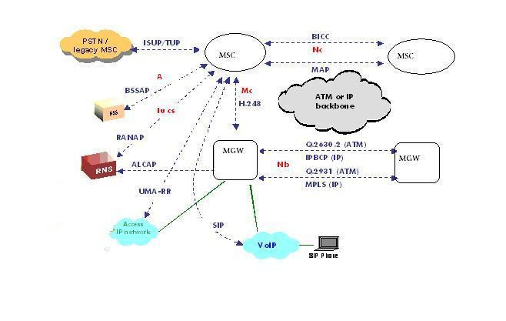
Telecom Network Protocols

Slide 3
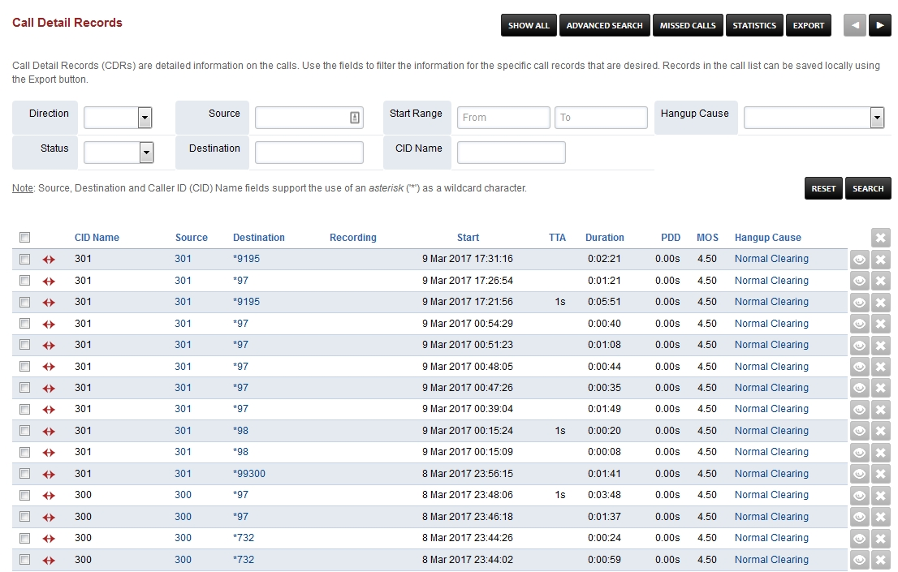
Call Detail Records

Slide 4

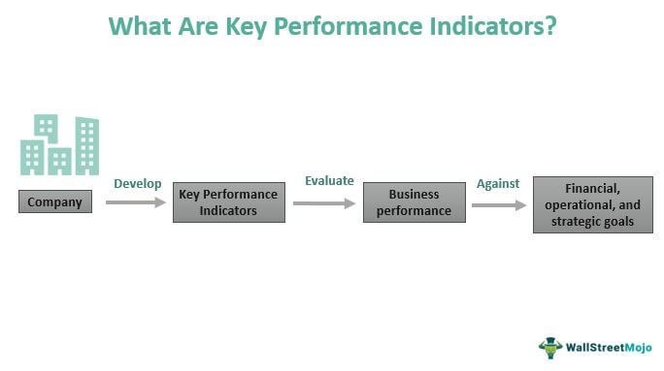
Key Point Indicator

Slide 5
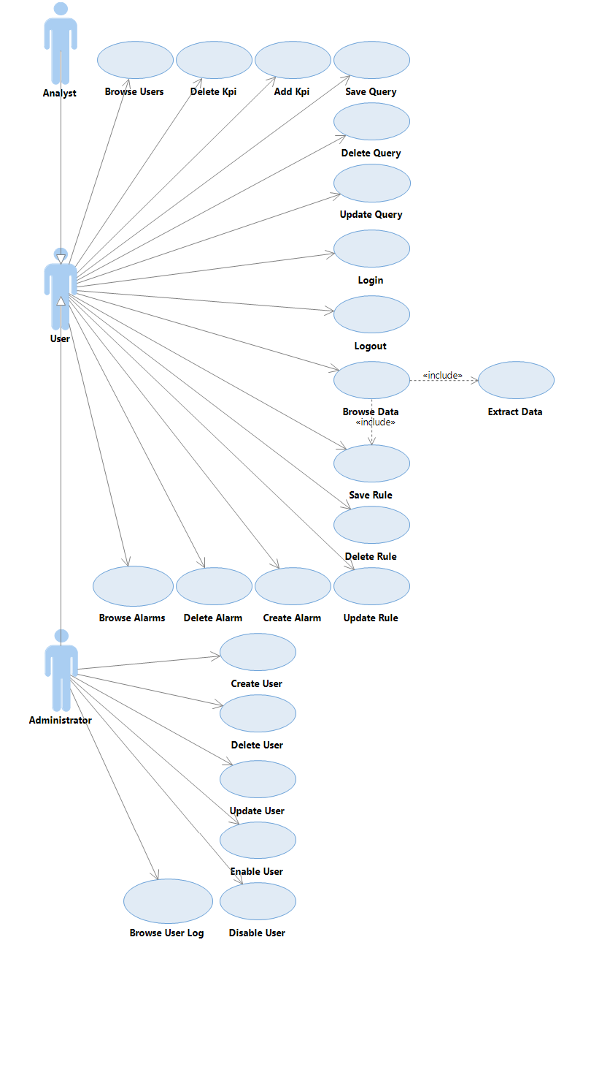
Use Cases

Slide 6
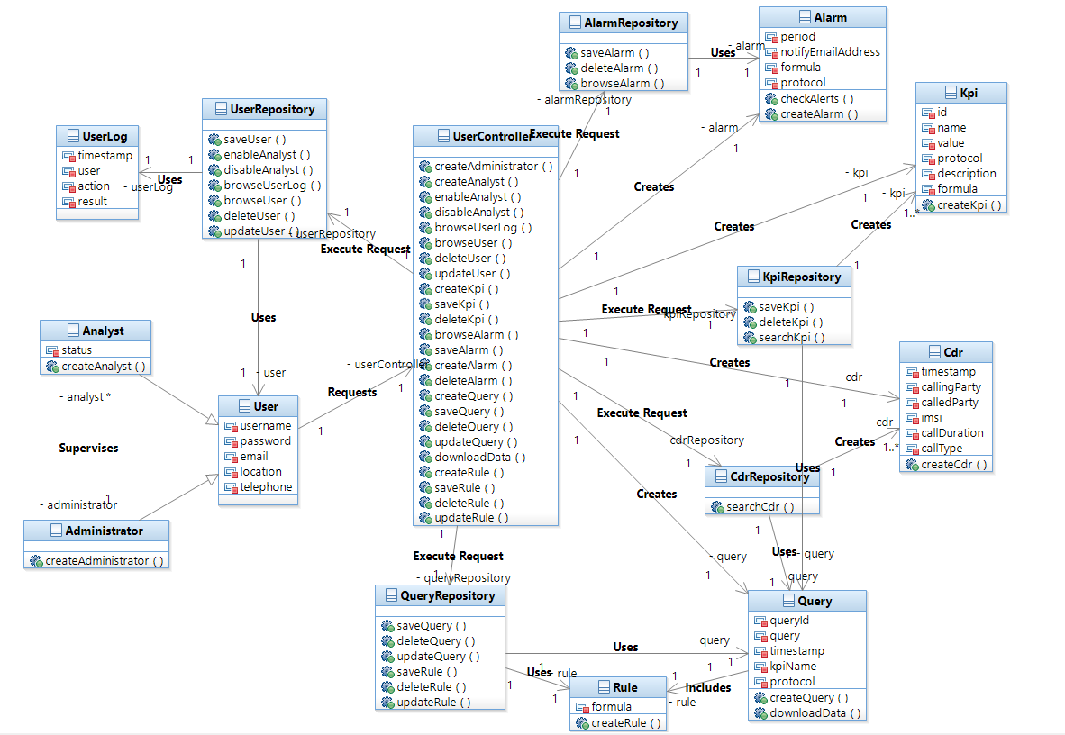
Class Diagram

Slide 7
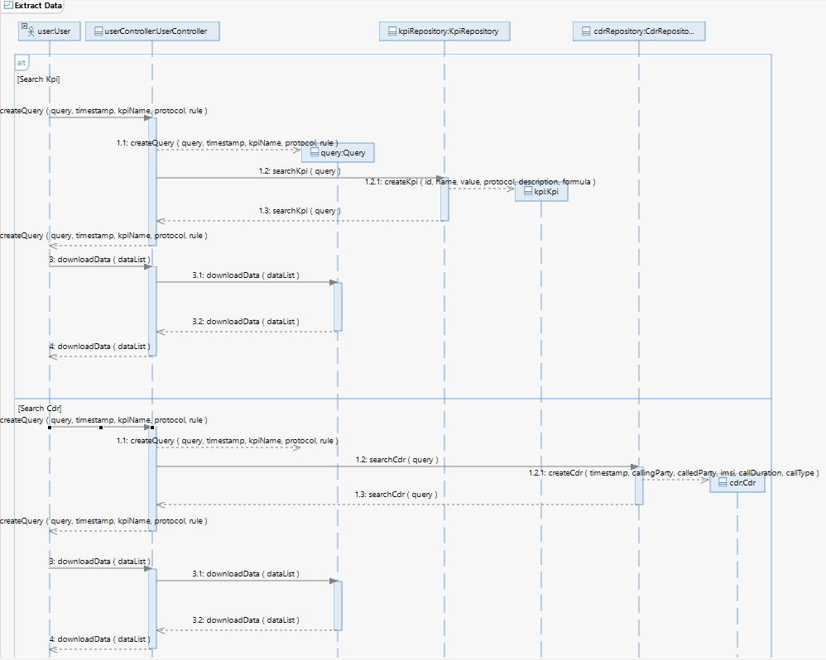
Sequence Diagram

